Slide 1
OPRCP: approximate nearest neighbor binary search algorithm for hybrid data over WMSN blockchain

Slide 2
Introduction
Basics, problem definition
Preliminaries
Approximate Nearest Neighbor, Locality sensitive Hashing, Blockchain, IPFS
Proposed system model
Experiments and performance evaluation
Conclusion

Slide 3
Introduction: What is a WMSN?
Spatially dispersed autonomous devices that use sensors to monitor physical or environmental conditions.
sensor nodes equipped with multimedia devices, such as cameras and microphones, and capable to retrieve video and audio streams, still images, as well as scalar sensor data.
A wide range of applications: surveillance sensor networks, law-enforcement reports, traffic control systems, advanced health care delivery, automated assistance to elderly telemedicine, and industrial process control.

Slide 4
Introduction: Problem definition
Massive amount of data is being collected by multimedia sensors. Some of it is considered sensitive and are vulnerable to tampering attacks while being queried by users (i.e clients).
The aim of the presented paper is not only to use blockchain technology to solve privacy issues associated to multimedia data search within sensor networks, but also to provide a novel method to carry out collaborative search an.d improve the precision of query results.

Slide 5
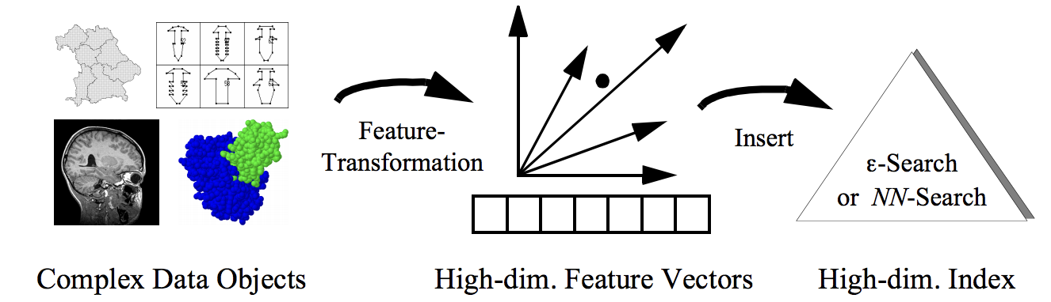
Introduction: Problem definition
query of massive multimedia data is composed of three procedures:
Extraction of multimedia data features
Creation of query indexes on feature data in datasets
Mapping query objects into the query index structure

Slide 6
Introduction: Problem definition
With regard to multimedia data search on WMSN blockchain and IPFS, existing methods are challenged in three aspects:
Curse of space (creating index structures for the massive data itself consumes larger space )
Curse of dimensionality (the processing of hybrid data requires the consideration of multiple data features at the same time )
Curse of growth (the requirement of scalable index structures )

Slide 7
Introduction: Problem definition
The proposed solution consists of a novel hybrid data query method OPRCP (One Permutation with Rotation and Cross-Prototype locality sensitive hashing) which is a kind of approximate nearest neighbor binary search for WMSN binary hybrid data (image-text or image-audio).

Slide 8
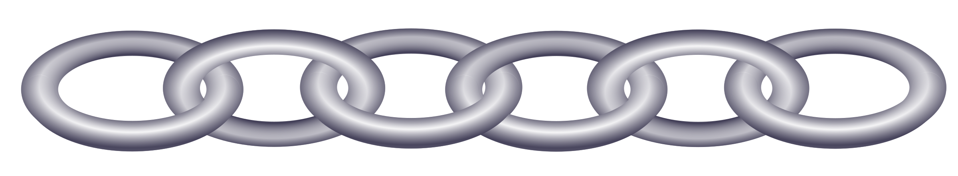
Preliminaries: Blockchain technology?
Like the name indicates, a blockchain is a chain of blocks that contains information.
It was originally described by a group of researchers in 1991 to timestamp documents so that it is not possible to backdate them or to tamper with them.

Slide 9
Preliminaries: Blockchain technology?
Until 2009, it was adopted by satoshi Nakamoto to create the digital cryptocurrency Bitcoin.
Distributed ledger
Once the data is recorded inside a blockchain it becomes very difficult to change it ?
Data
Hash
Hash of previous block

Slide 10



Preliminaries: Blockchain technology?
Until 2009, it was adopted by satoshi Nakamoto to create the digital cryptocurrency Bitcoin.
Distributed ledger
Once the data is recorded inside a blockchain it becomes very difficult to change it ?
From:
Data
To:
Hash
Amount:
Hash of previous block

Slide 11

Preliminaries: Blockchain technology?
Until 2009, it was adopted by satoshi Nakamoto to create the digital cryptocurrency Bitcoin.
Distributed ledger
Once the data is recorded inside a blockchain it becomes very difficult to change it ?
Cf23df2207d99a74fbe169e3eb
aestdfgg34r4207d99a74fbe169
Hash

Slide 12


Preliminaries: Blockchain technology?
1
2
3
Genesis block
Hash: 1Z8F
Previous hash: 0000
Hash: 6BQ1
Previous hash: 1Z8F
Hash: 3HAQ
Previous hash: 6BQ1
H62Y
That’s not right?
Proof of work

Slide 13




Preliminaries: IPFS?
How do we access contents on the web right now?
Eg. Photo download
Location-based addressing:
In case the server is down we can’t get the photo

Slide 14
Preliminaries: IPFS?
content
Location-based addressing
Instead of saying where to find a resource
We say what it is we want
Give me the picture with key Cf23df2207d99

Slide 15
Preliminaries: IPFS?
Files are stored inside IPFS objects and these objects can store up to 256 kb worth of data.
If the files are larger than 256 kb they are split up into multiple IPFS objects that are all of 256kb in size. The system then will create an empty IPFS object that links to all other pieces of the file.
Links. [ ]
IPFS object
Data ‘Hello world’

Slide 16
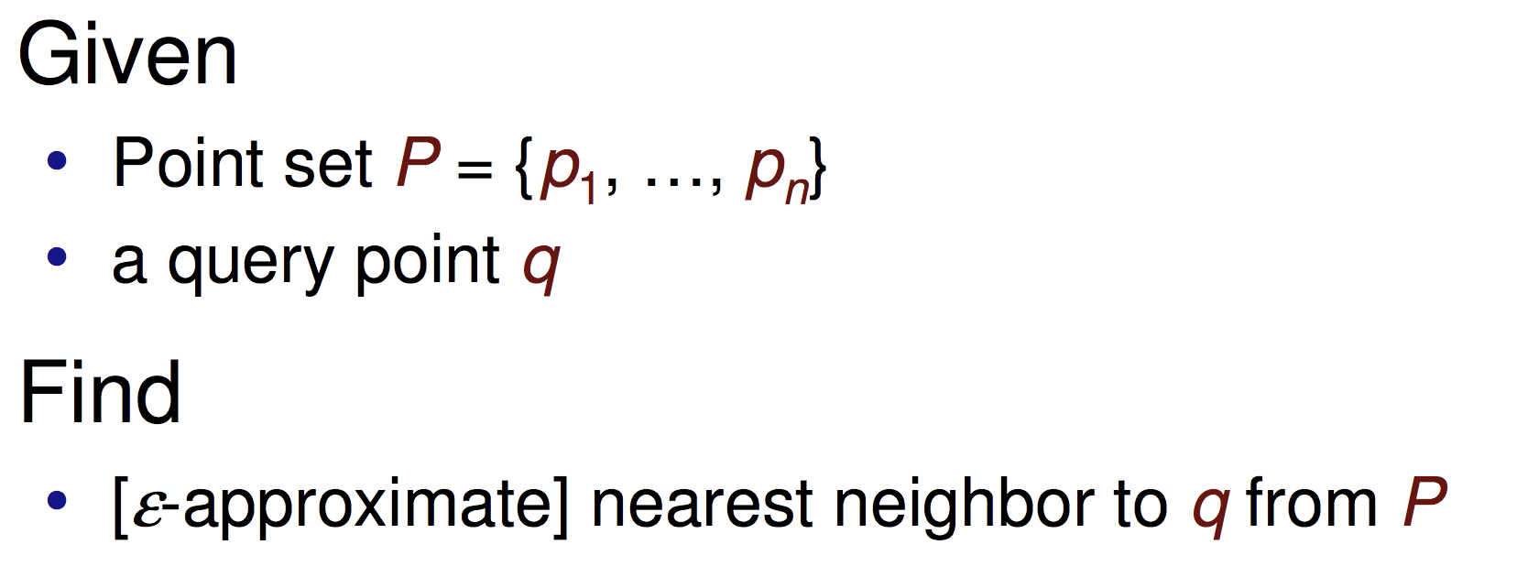
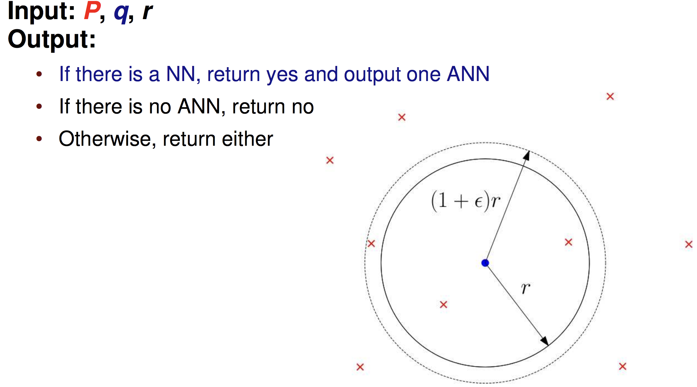
Preliminaries: approximate nearest neighbor ?

Slide 17
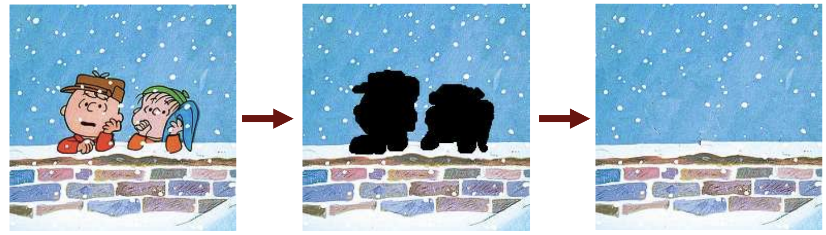
Preliminaries: approximate nearest neighbor ?
Real-world example: Image completion

Slide 18
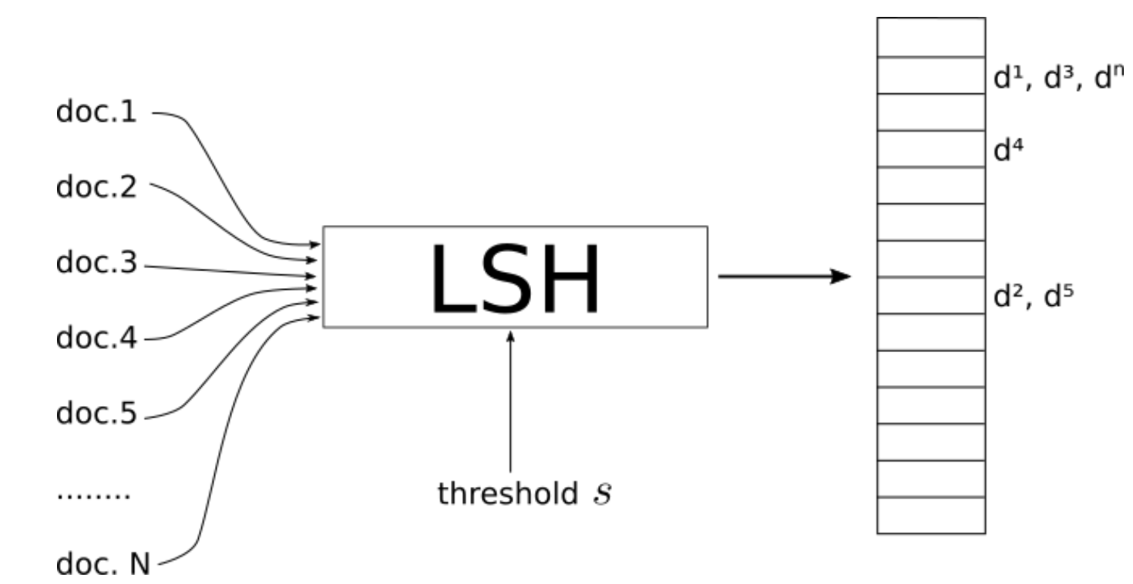
Preliminaries: Locality sensitive hashing ?
LSH is a procedure that takes as input a set of documents/images/objects and outputs a kind of Hash Table.
The indexes of this table contain the documents such that documents that are on the same index are considered similar and those on different indexes are "dissimilar".
threshold similarity s which acts like a global parameter of LSH.

Slide 19
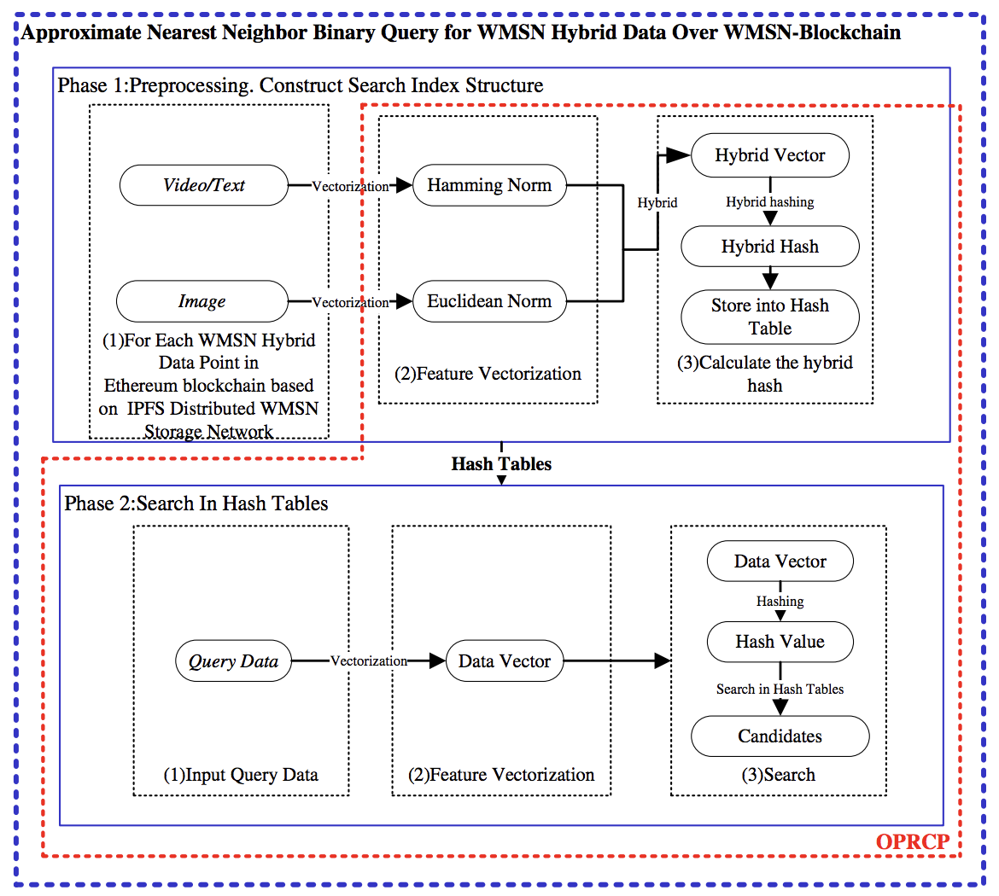
Proposed system model

Slide 20
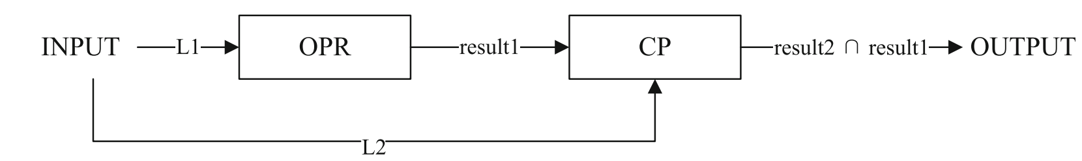
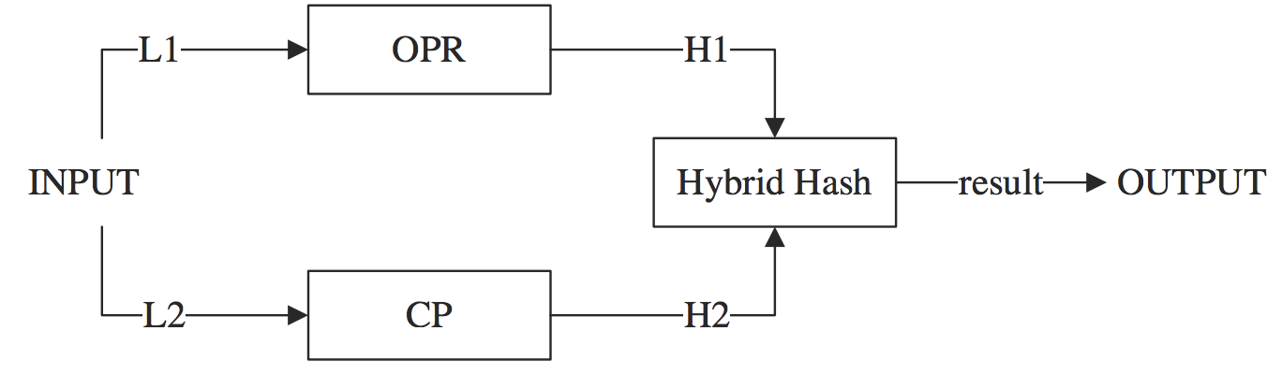
Proposed system model
For the hamming space
For the Euclidean space (cross-polytope LSH method)

Slide 21
Experiments and performance evaluation
MNIST is a standard handwritten digit dataset, which is oriented to the Euclidean space.
MINST was then converted to binary data by binarization and combined with the original Euclidean spatial data to construct a binary hybrid dataset.
The experiment was run on a PC with an operating system Arch Linux, Intel Corei7-4510U 3.1 GHz CPU and 8 GB of memory. All the code used in the experiment was implemented based on Python 3.6
The system was compared to other systems from the literature such as We implemented BHL, TLBHL, and TLE2LSH.

Slide 22
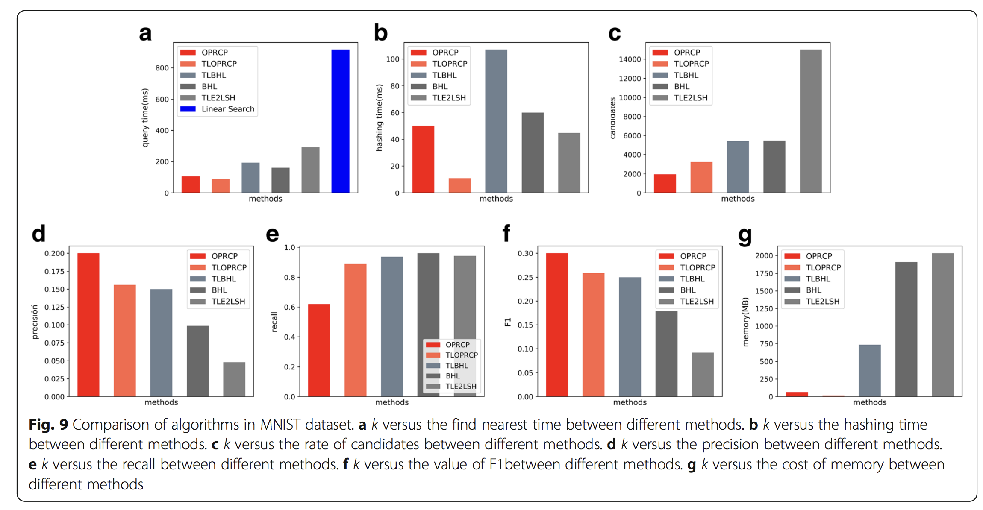
Experiments and performance evaluation

Slide 23
Conclusion
In view of preventing sensitive data of WMSN IoT to be tampered, it is a feasible solution to build a blockchain application of WMSN IoT based on Ethereum and IPFS.
we use a kind of LSH method to perform similarity search on the binary hybrid data and construct the query data structure; by preprocessing the dataset, we can obtain a more efficient dimension-insensitive query time
A large number of experiments have proved that our method has lower query time and space consumption than previous methods, and it is universal for various datasets.

Slide 24
Future work
For their further works, authors are trying to construct a binary hybrid data search structure with missing values and extend the approximate nearest neighbor search to solve the problem of incomplete data.

